Slide 1
Best Practices for ATAC-seq data QC and analysis
July 28, 2020
Haibo Liu¹, Jianhong Ou², Kai Hu¹, Lihua Julie Zhu³
¹ Department of Molecular, Cell and Cancer Biology, Umass Medical School
² Department of Cell Biology, Duke University Medical Center, Duke University
³ Department of Molecular, Cell and Cancer Biology, Program in Molecular Medicine, Program in Bioinformatics and Integrative Biology, UMass Medical School

Slide 2
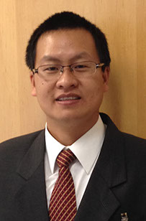

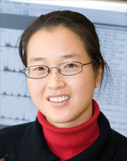


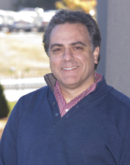


Acknowledgement
Jianhong Ou
Lihua Julie Zhu
Nathan Lawson
Michelle Kelliher
Lucio Castilla
BioC2020 Organization Committee

Slide 3
Outline
Introduction to the ATAC-seq technology
Preprocessing of ATAC-seq data
ATACseqQC workflow
Best practices of ATAC-seq assays and ATAC-seq data analyses
Exercises and live demonstration
Q & A

Slide 4
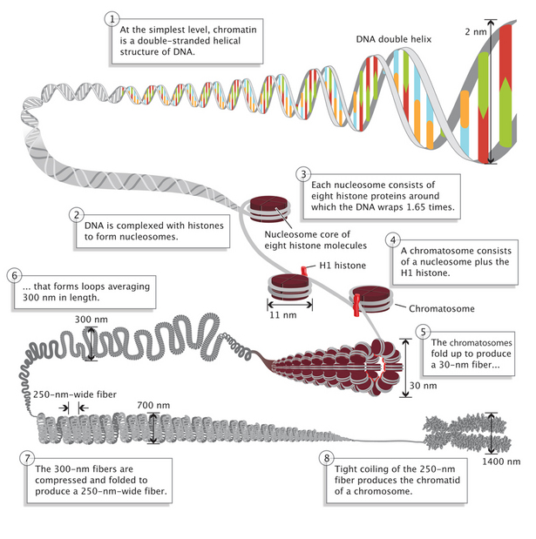
DNA packaging in Eukaryotic cells
Nature Education 1(1):26 (https://www.nature.com/scitable/topicpage/dna-packaging-nucleosomes-and-chromatin-310)

Slide 5
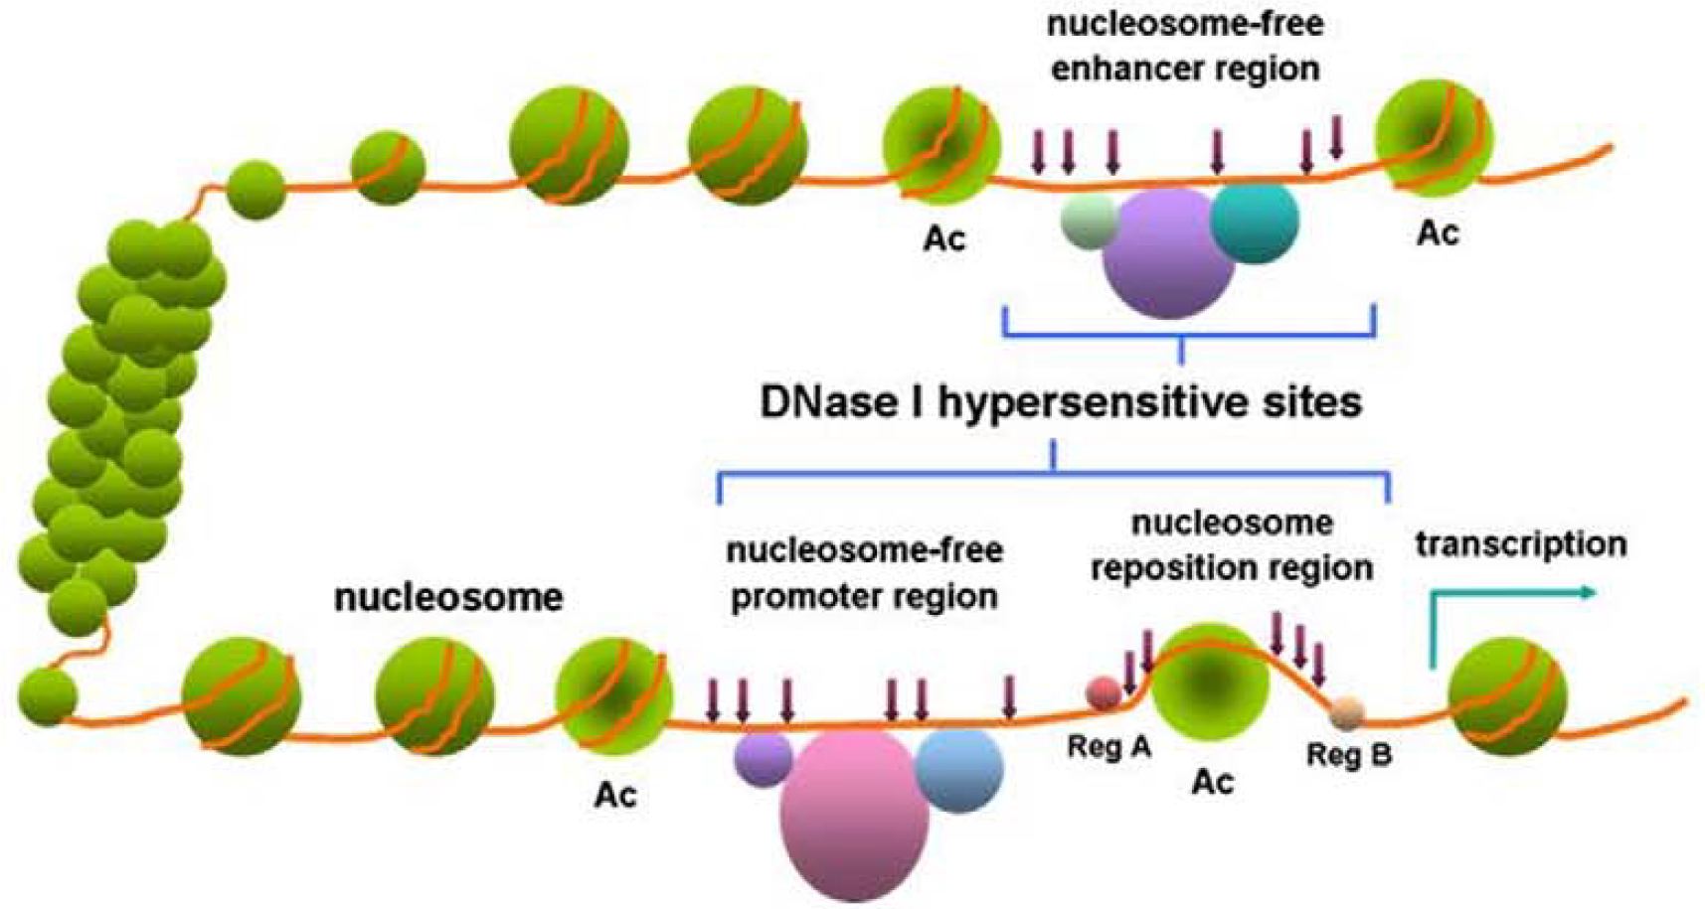
Open and closed chromatin
Closed chromatin
Open chromatin
(Wang et al. 2012)

Slide 6
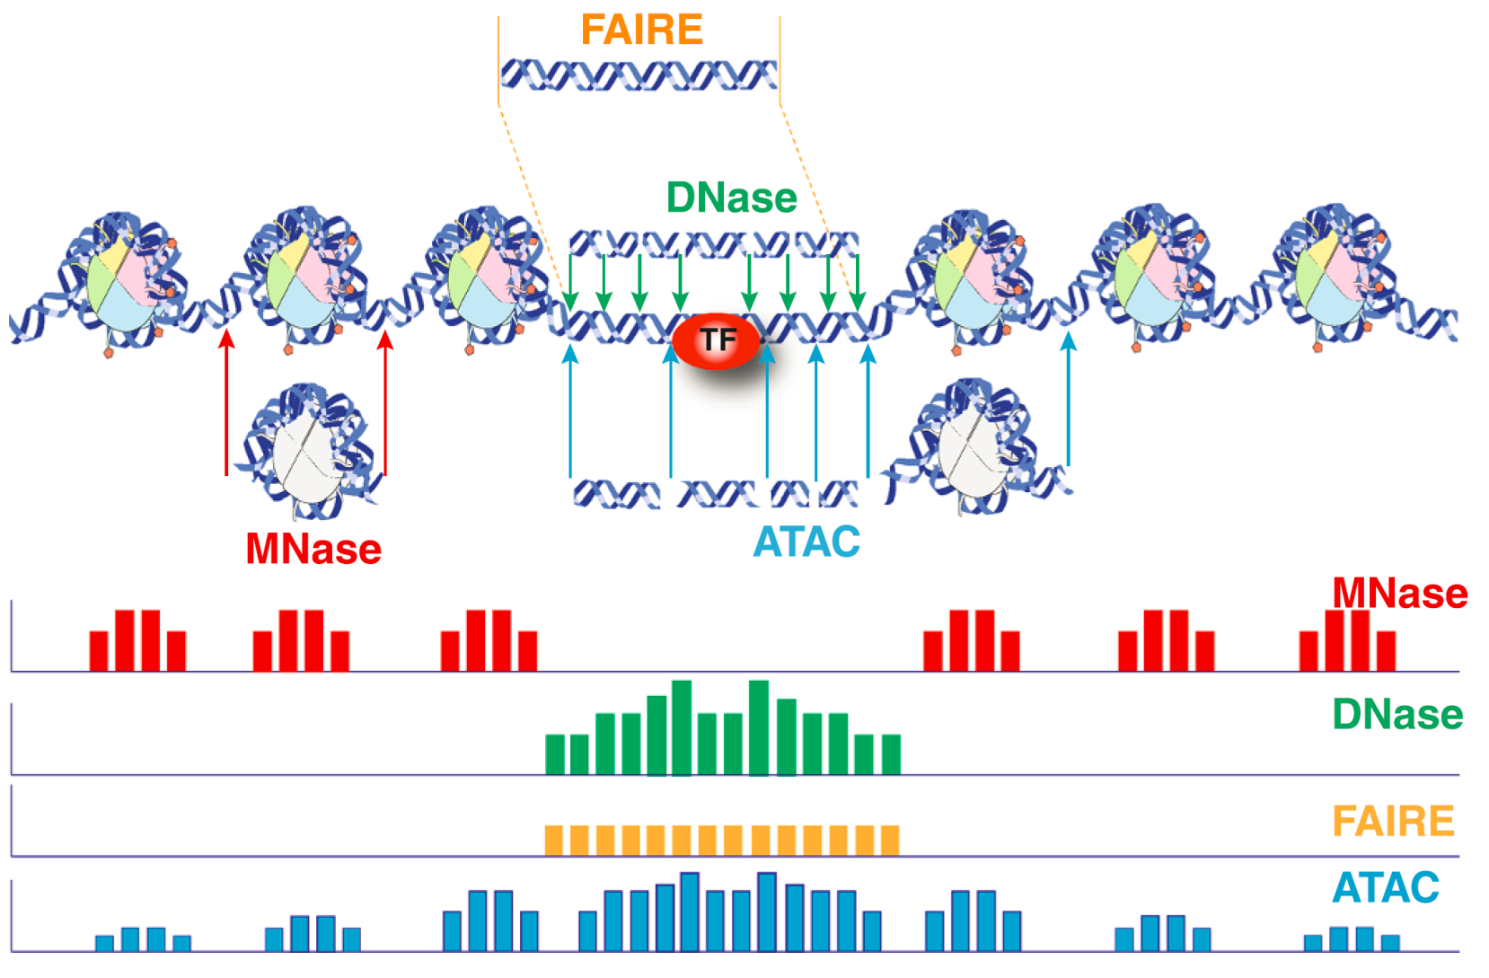
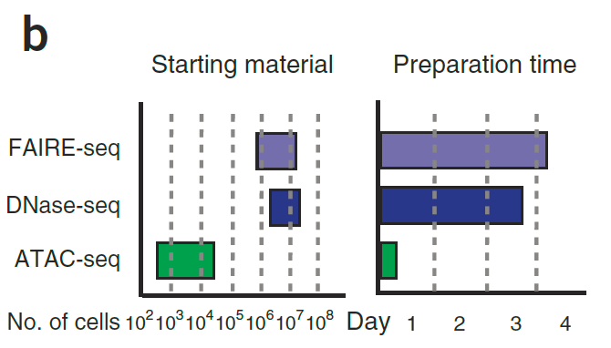
Methods for profiling chromatin accessibility
(Tsompana and Buck. 2014)
(Buenrostro et al. 2013)

Slide 7
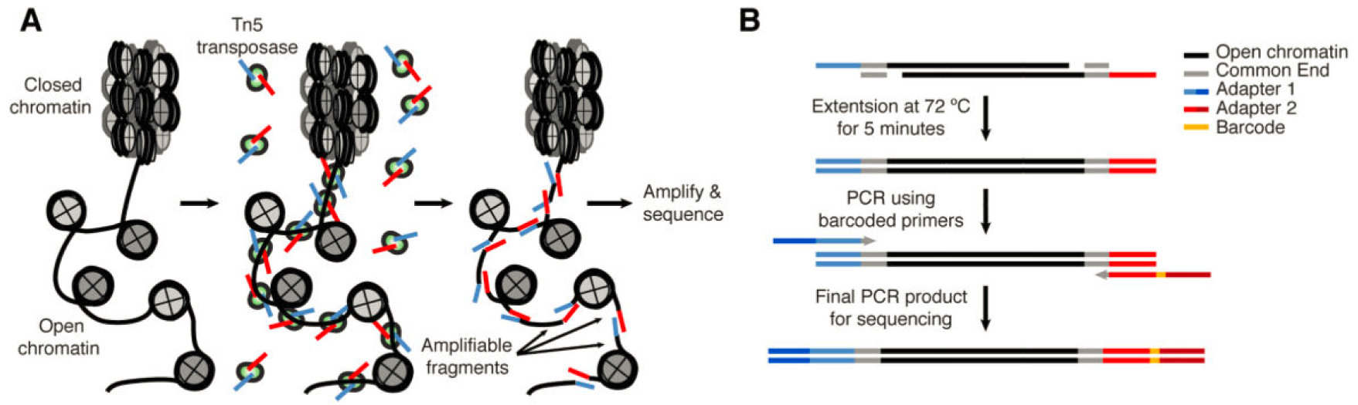
Workflow of ATAC-seq assays
62 bp
66 bp
38 ~ 2000 bp
(Buenrostro et al. 2013)

Slide 8
Applications of ATAC-seq
Profile open chromatin regions
Infer nucleosome positioning
Identify transcription factor (TF) footprints
Infer gene transcriptional regulation
Determine cell state/identity in combination with single cell technologies (scATAC-seq)

Slide 9
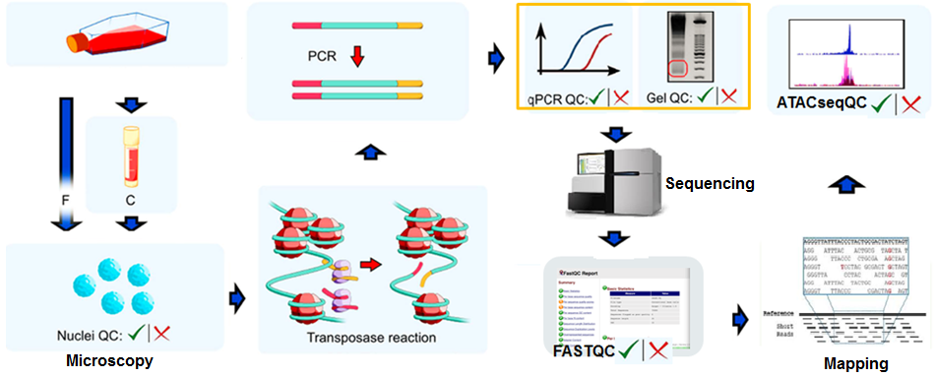
Important QC steps in ATAC-seq
(Modified from Milani et al. 2016)

Slide 10
Outline
Introduction to the ATAC-seq technology
Preprocessing of ATAC-seq data
ATACseqQC workflow
Best practices of ATAC-seq assays and ATAC-seq data analyses
Exercises and live demonstration
Q & A

Slide 11
Preprocessing of ATAC-seq data
Check quality of raw reads using (FASTQC).
Generate an interactive summary report as a HTML file (MultiQC)
Optionally, trim sequencing adapters and low quality bases using (Trimmomatic or cutadapt)
Map reads to the reference genome of choice (Bowtie/Bowtie2 or BWA-mem)
Convert and sort alignment files (SAMtools or sambamba)
Filter aligned reads
Remove reads derived from organelles (SAMtools)
Mark/remove duplicates (Picard tools)
Remove mapping artifacts (fragments < 38 bp and fragments > 2 kb, reads with un-coordinated mapping or MAPQ < 20) (custom scripts)

Slide 12
Outline
Introduction to the ATAC-seq technology
Preprocessing of ATAC-seq data
ATACseqQC workflow
Best practices of ATAC-seq assays and ATAC-seq data analyses
Exercises and live demonstration
Q & A

Slide 13
(1) Assessing mapping status of reads from ATAC-seq
bamQC()
mapping status, such as mapping rate, duplicate rate, genome-wide read distribution, mapping quality, and contamination.
requires sorted BAM files with duplicate reads marked as input.
Alternatives: samtools or picard tools

Slide 14
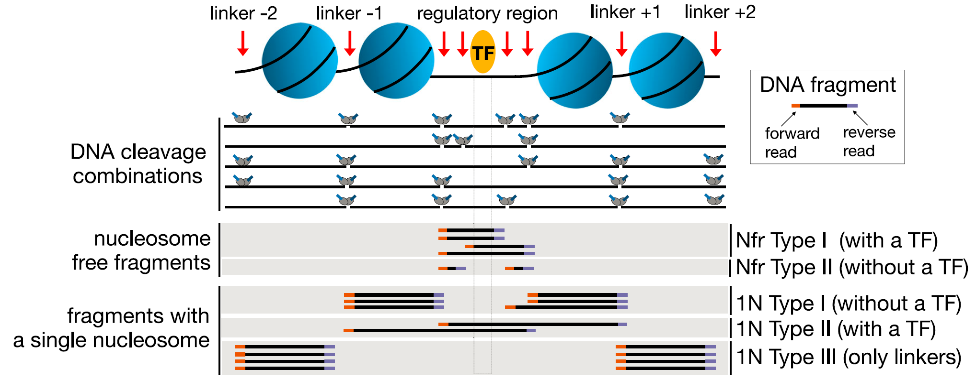
Characteristic DNA fragments generated in ATAC-seq assays
Dinucleosome
2N
(Modified from Li et al. 2019)

Slide 15
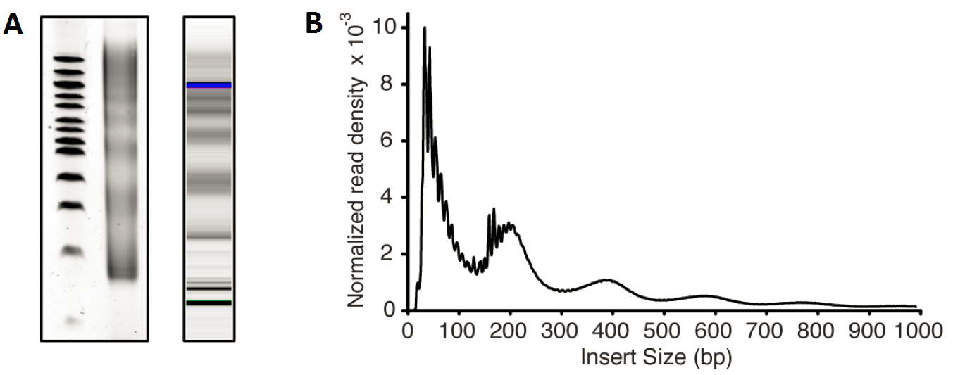
Typical size distribution of ATAC-seq library fragments/inserts
Library fragment size
Library insert size
bp
Nulceosome-free
Mononucleosome
300
Dinucleosome
200
Trinucleosome
100
Agarose gel
Bioanalyzer
(Buenrostro et al. 2015)

Slide 16


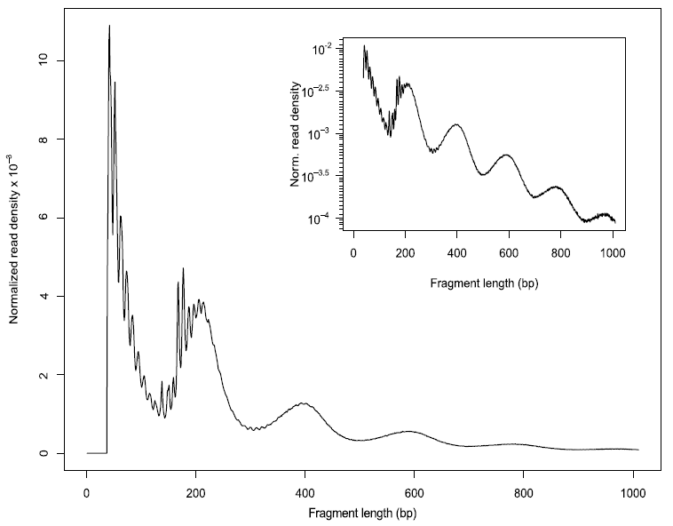
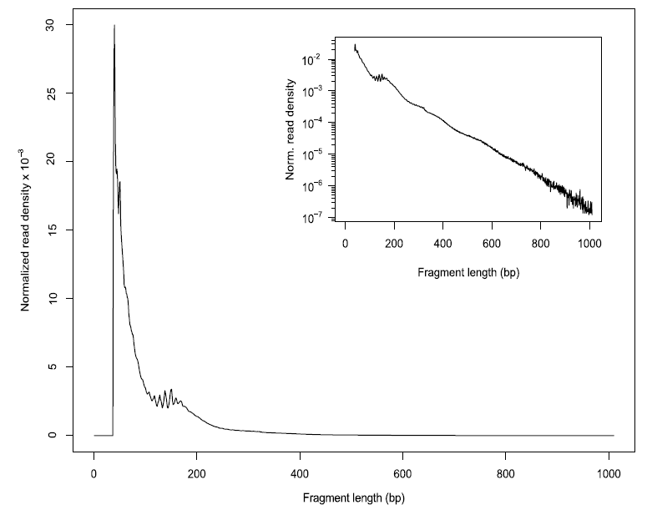
(2) Assessing insert size distribution
fragSizeDist()
A (High quality)
B (Poor quality)
(Ou et al. 2018)

Slide 17
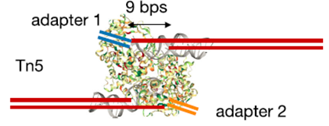
(3) Shifting aligned reads
Tn5 Tnp-mediated tagmentation produces DNA fragments with 5’ 9-base overhang ends
(Li et al. 2019)
shiftGAlignmentsList()

Slide 18
(4) Splitting BAM files
splitGAlignmentsByCut()
Nucleosome-free Mononucleosome Dinucleosome Trinucleosome
Dinucleosome
2N
(Modified from Li et al. 2019)

Slide 19
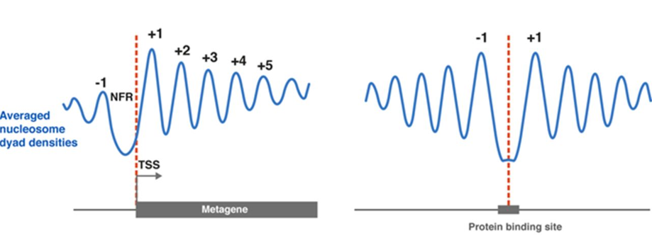
Nucleosome positioning around TSSs (A), enhancers and insulators (B)
A
B
(Baldi. 2018)

Slide 20
(5) Plotting aggregrate signal distribution around transcriptional start sites (TSSs)
enrichedFragments():calculate signals around TSSs using the split BAM objects
featureAlignedHeatmap(): generate a heatmap showing signal distribution around TSSs
matplot(): summarize the signal distribution around TSSs using a density plot

Slide 21
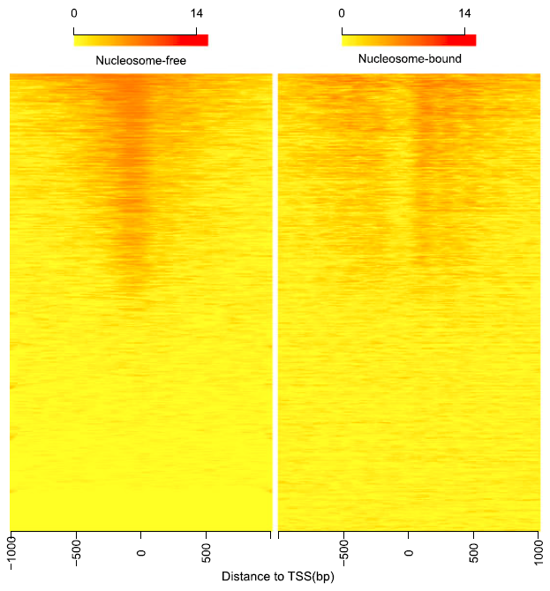
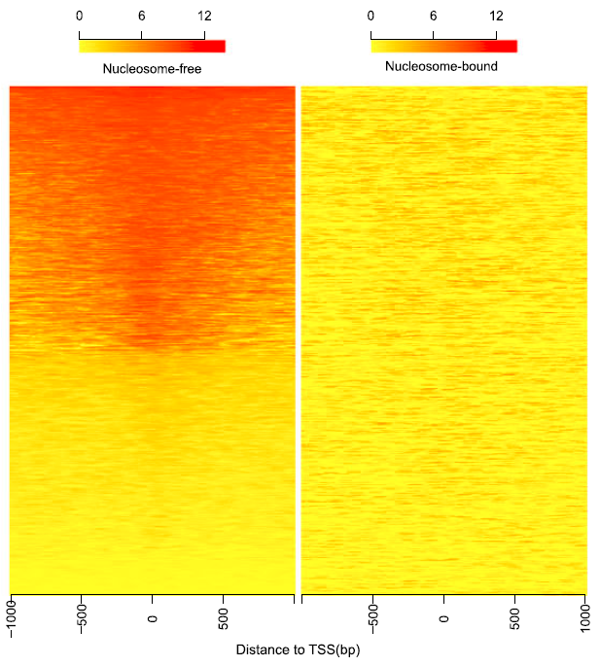
Heatmaps showing distribution of reads from different bins around TSSs
A (High quality)
B (Poor quality)
(Ou et al. 2018)

Slide 22
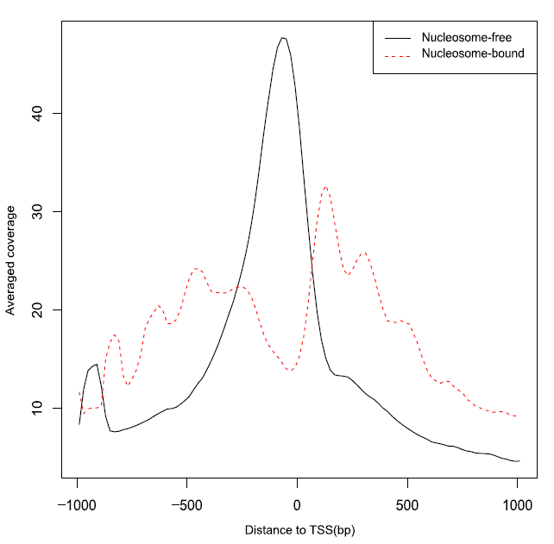
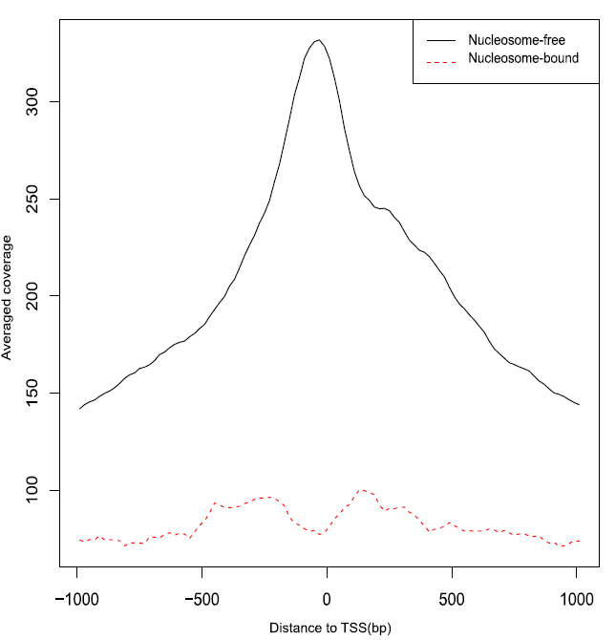
Density plots showing distribution of reads from different bins around TSSs
A (High quality)
B (Poor quality)
(Ou et al. 2018)

Slide 23
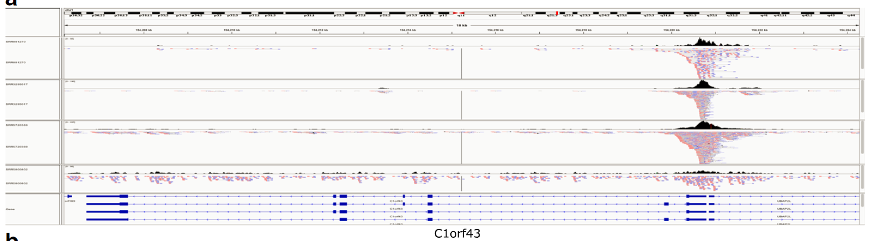

(6) Streamlining IGV snapshots showing reads distribution along HK genes
## access the function IGVSnapshot()
source(system.file("extdata", "IGVSnapshot.R", package = "ATACseqQC"))
## streamline IGV snapshots
IGVSnapshot(maxMem="lm", genomeBuild = "hg19",
bamFileFullPathOrURLs = bamFile,
geneNames = c("C1orf43", "GAPDH"))
(Ou et al. 2018)

Slide 24
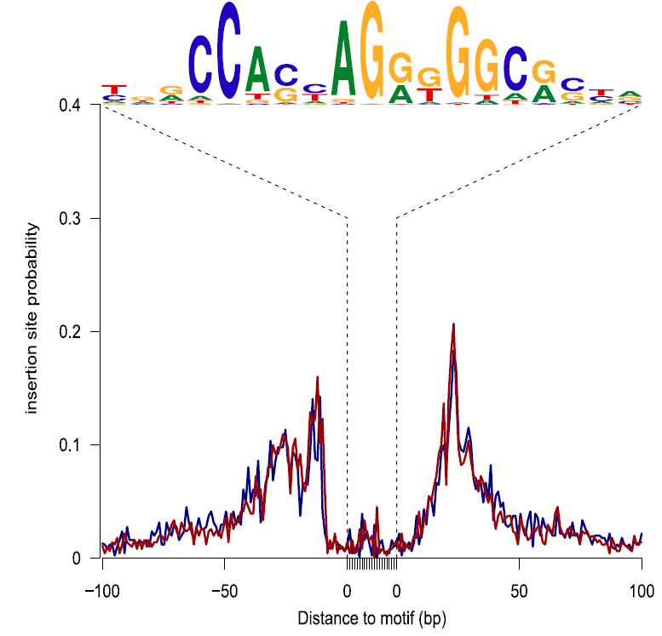
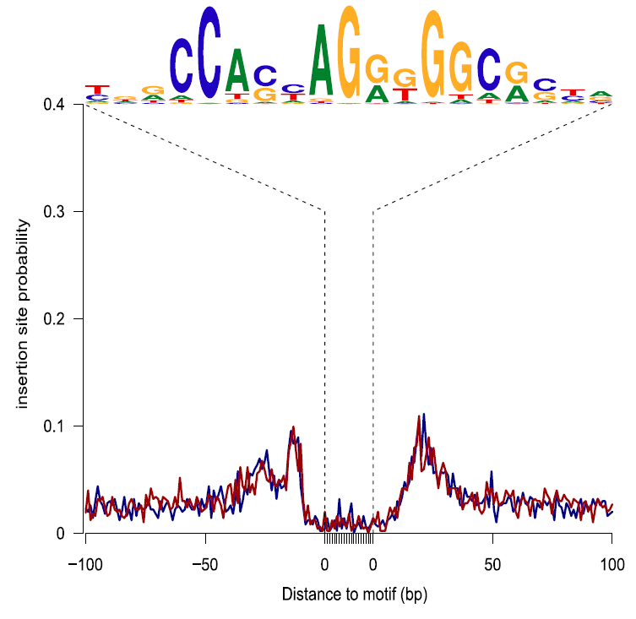
(7) Assessing footprints of DNA-binding factors
factorFootprints()
A (High quality)
B (Poor quality)
(Ou et al. 2018)

Slide 25
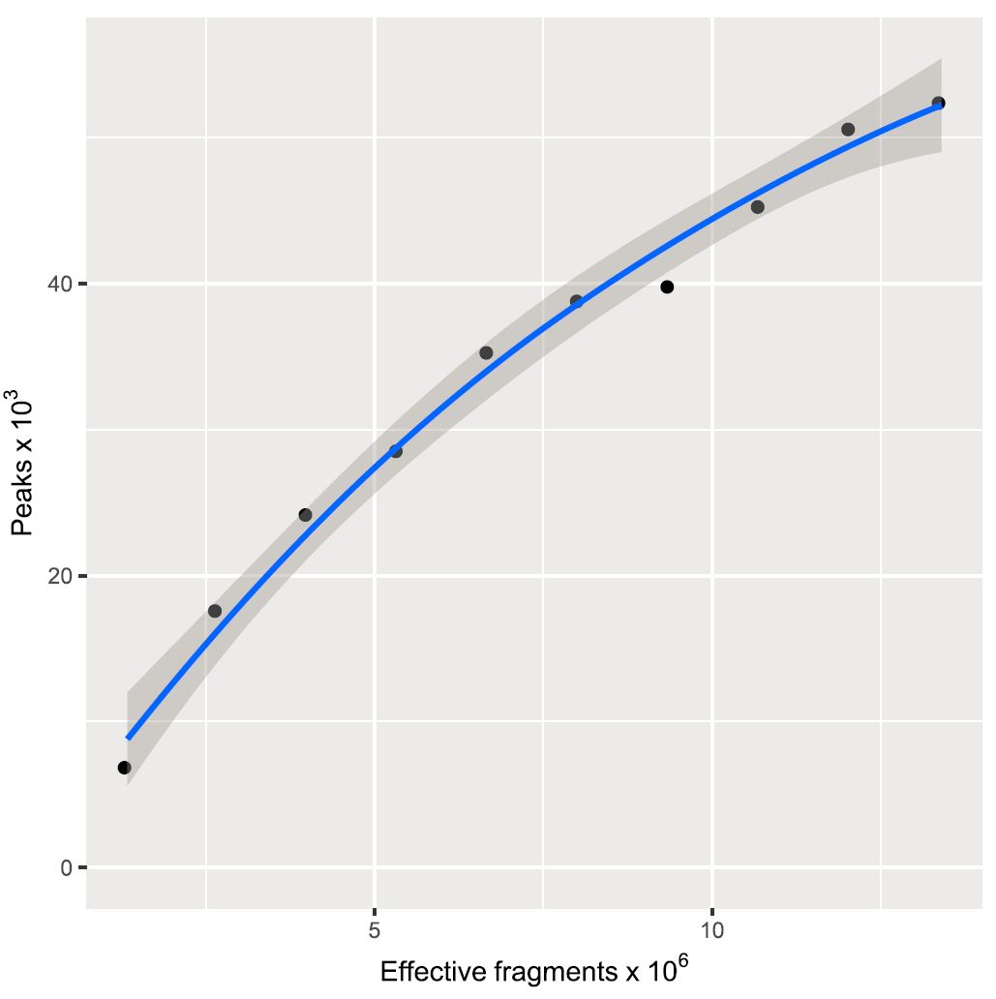
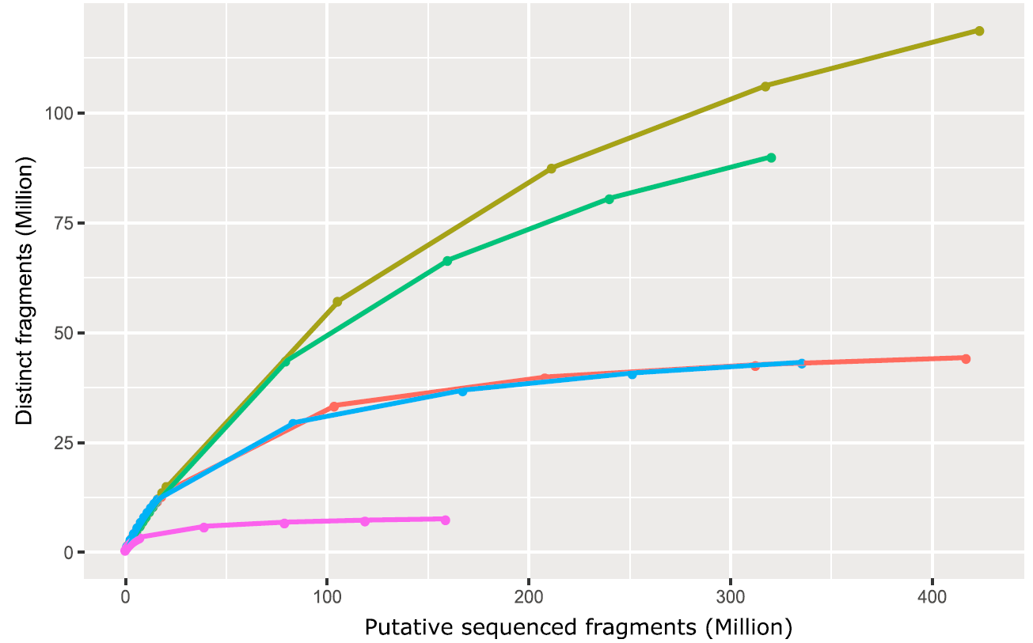
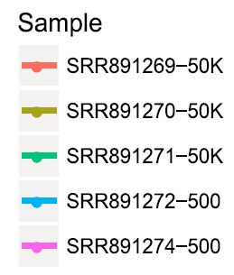
(8) Assessing sequencing depth and library complexity
saturationPlot()
estimateLibComplexity()
(Ou et al. 2018)

Slide 26
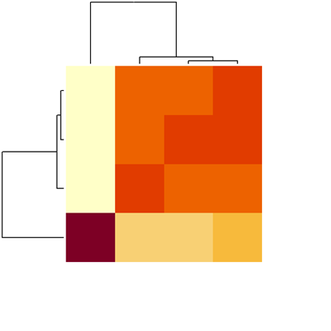
(9) Assessing similarities of replicates
plotCorrelation()
Rep_1
Rep_2
Rep_3
Rep_4
Rep_1
Rep_2
Rep_3
Rep_4

Slide 27
Outline
Introduction to the ATAC-seq technology
Preprocessing of ATAC-seq data
ATACseqQC workflow
Best practices of ATAC-seq assays and ATAC-seq data analyses
Exercises and live demonstration
Q & A

Slide 28
Best practices for ATAC-seq assays
Digest away background DNA (medium/dead cells) using Dnase I
Use fresh/cyropreserved cells/tissues to isolate nuclei
Reduce mitochondrial/chloroplast DNA contamination using the Omni-ATAC protocol: bamQC()
Optimize the ratio of the amount of Tn5 enzyme to nucleus counts: fragSizeDistr()
Optimize the number of PCR cycles:
Perform paired-end (PE) sequencing, e.g., 2 x 40 ~ 100 bp
Sequence > 50M PE reads (~200 M for footprint discovery): saturationPlot(), estimateLibComplexity()

Slide 29
Best practices for ATAC-seq data analyses
Perform raw read QC before alignment—FASTQC/MultiQC
Perform post-alignment QC—ATACSeqQC
Perform peak calling using peak callers, such as Genrich, MACS2 (shift –s extend 2s) to call narrowPeak, or HMMRATAC
Perform post-peak calling QC
Associate peaks to potential target genes and generate peak distribution among genomic features—ChIPpeakAnno
Functional annotation of peaks using the Genomic Regions Enrichment of Annotations Tool (GREAT) or chipenrich (http://chip-enrich.med.umich.edu/), or BEHST (http://behst.hoffmanlab.org/) if long-range interaction data is available.
Nucleosome positioning analysis—NuceloATAC (https://github.com/GreenleafLab/NucleoATAC)
Footprinting analysis—TOBIAS (https://github.molgen.mpg.de/loosolab/TOBIAS)
Transcriptional regulatory network inference with paired RNA-seq and ATAC-seq data—PECA2 (https://github.com/SUwonglab/PECA)

Slide 30


Data for exercises and live demonstration
ATAC-seq datasets 1 (Good):
SRR891269 and SRR891270 are ATAC-seq data for two biological replicates of 50K cells from EBV-transformed lymphoblastoid cell line GM12878 (Buenrostro et al. 2013).
ATAC-seq datasets 2 (Bad):
SRR5800801 and SRR5800802 are ATAC-seq data for two replicates of 75k cells from a breast cancer cell line T47 (Valles and Izquierd-Bouldstridge, unpublished).
Raw read quality QC (FASTQC) → Alignment to hg38, excluding alternative sequences (chr_alt_XXX).
The resulting BAM files were further preprocessed as above and are available from the Google Drive.
Two subsets of filtered BAM files from SRR891270, containing alignments on chr20 only, are provided in this workshop package for quick in-class practice.

Slide 31
Exercises and live demonstration
Task 1. Check read alignment statistics using the function bamQC. Using BAM files with marked duplicates.
Task 2. Check library complexity for SRR891270 using the function estimateLibComplexity. CAUTION: duplicated should NOT be removed from the input BAM file.
Task 3. Plot the distribution of library insert size using the function fragSizeDist.
Task 4. Plot global signal enrichment around TSSs using the function enrichedFragments. Please shift, and split the BAM file first. Make sure set seqlev as chr20.
Task 5. Visualize signal distribution along genomic regions of genes “SPTLC3”, “CRLS1”, and “NELFCD”, using the function IGVSnapshotand the 4 subsets of filtered BAM files.

Slide 32
Q & A

